Slide 1
SEIS 603 Semester Python Project By Robert Krall

Slide 2
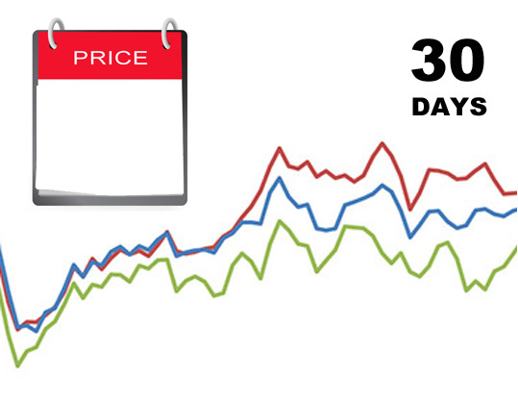
Product Price Tracker App
http://en.prixan.com

Slide 3





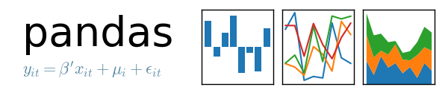



Technology used

Slide 4
Gather Data
Web Scrapping
Used Beatifulsoup library
Target, Walmart, Toys R Us, Brooks Running
API
Amazon
Run Script everyday to dump daily price into database

Slide 5
Application Functionality
Create Account
Add New Items
Track Multi Items Price Over Time

Slide 6
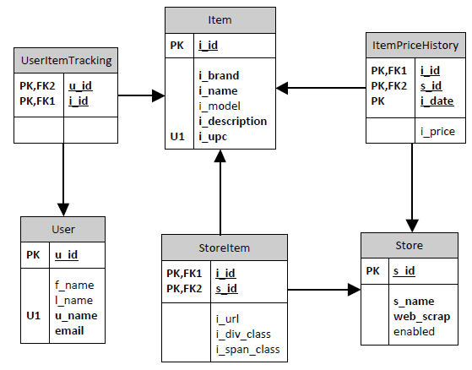
Entity Relationship Diagram

Slide 7
Report Sample
Looks View a report in Jupyter

Slide 8

Questions
http://startupmanagement.org

